Slide 1
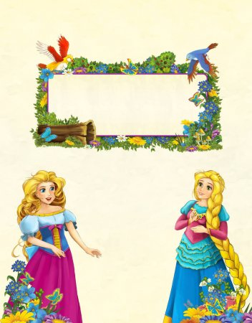
Body talk
5-th form
Teacher: Iskandarova Tolgonai Eshankulovna

Slide 2
Thumbs up
This is very popular gesture in many countries.
It shows that we like something or agree with something.
But in some Islamic countries , for example in Bangladesh, its very rude.

Slide 3
HORNS
When you raise your index finger and little finger in Spain or Italy , you want to say that your partner is cheating on you. Fans of heavy metal understand this gesture as <Rock on>. In some parts of Africa you can use this gesture to wish bad luck to other people.

Slide 4
V-GESTURE
There are two variants of this gesture. It means victory or peace. People , especially in Japan , use this gesture posing on a photograph as a friendly gesture. But watch out! When the palm of your hand faces you, in the UK, Australia, Ireland and New Zealand this gesture is very rude.

Slide 5
OK- GESTURE
In many English – speaking countries this gesture means that everything is good. But be careful to use this gesture in Brazil. For Brazilian people its very rude.

Slide 6
HOMEWORK
You have to find 5 gestures and draw.

