Slide 1
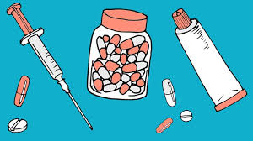
Theme: TREATMENTS- ЛЕЧЕНИЕ
мп
5-th form
Teacher:
Iskandarova
Tolgonai
Eshankulovna

Slide 2
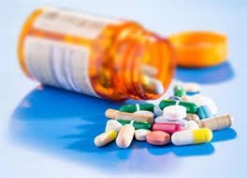
New words –Новые слова
Plaster –пластырь (накладывать гипс или пластырь)
Medicine-лекарство
Injection – препарат
Cream- лечебный крем
Syrup-сироп
Vitamin C
( Выучить слова)

Slide 3
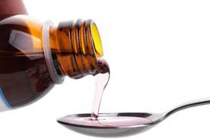
Exercise 2
1) Put some cream on the bruise
2)Take some syrup
3)Put on a plaster
4)Take some medicine
5)Take Vitamin C
6)Have an injection
Answer this questions-Отвечайте на эти вопросы.
1.When you have got the fiu, how do you feel?
2. What do you do to get better?

Slide 4
Homework
Прочитайте выражения, вставьте подходящие названия болезней:
headache (головная боль), B) toothache (зубная боль), C) sore throat (боль в горле), D) stomachache (боль в животе), E) pain in the knee (боль в колено).
1. Pamela ate too much ice-cream yesterday and today she has got a______.
2. Tom played football yesterday. He fell down and now he has got a _______.
3. Den didn’t wash his hands before supper yesterday and today he has got a _
4. Amanda often has got a ________ because she watches TV form morning till night.
5. Fred doesn’t visit dentist regularly, that’s why he often has got a _______.

