Slide 1
Seasons and months
School#1 teacher: Kozhomkulova A.T.

Slide 2

Seasons: winter, spring, summer, autumn

Slide 3
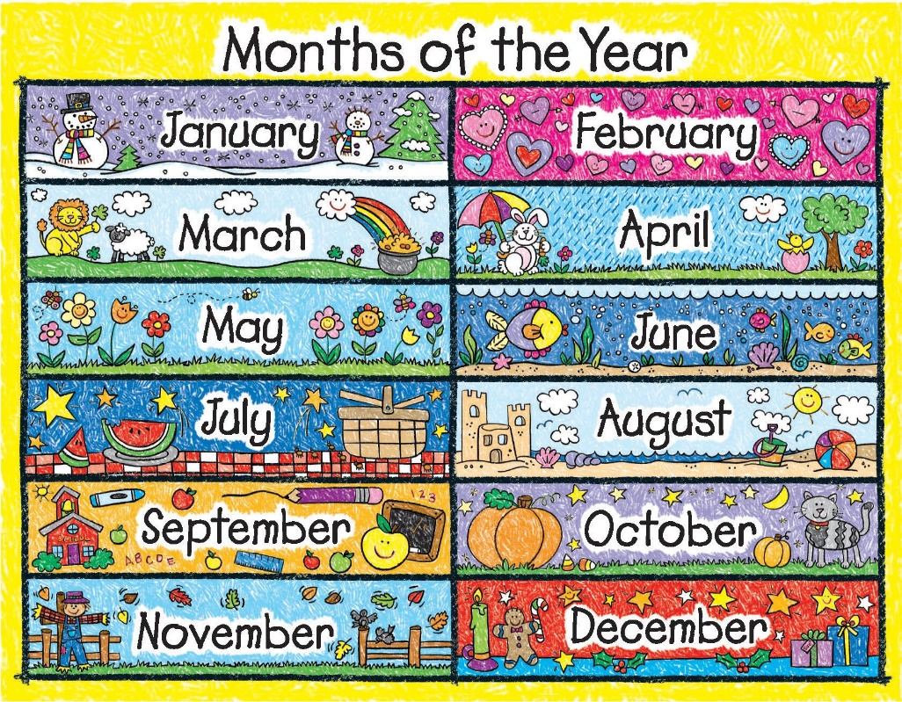
Months: January, February, March, April, May, June, July, August, September, October, November, December

Slide 4
Filling columns
Winter | Spring | Summer | Autumn

Slide 5
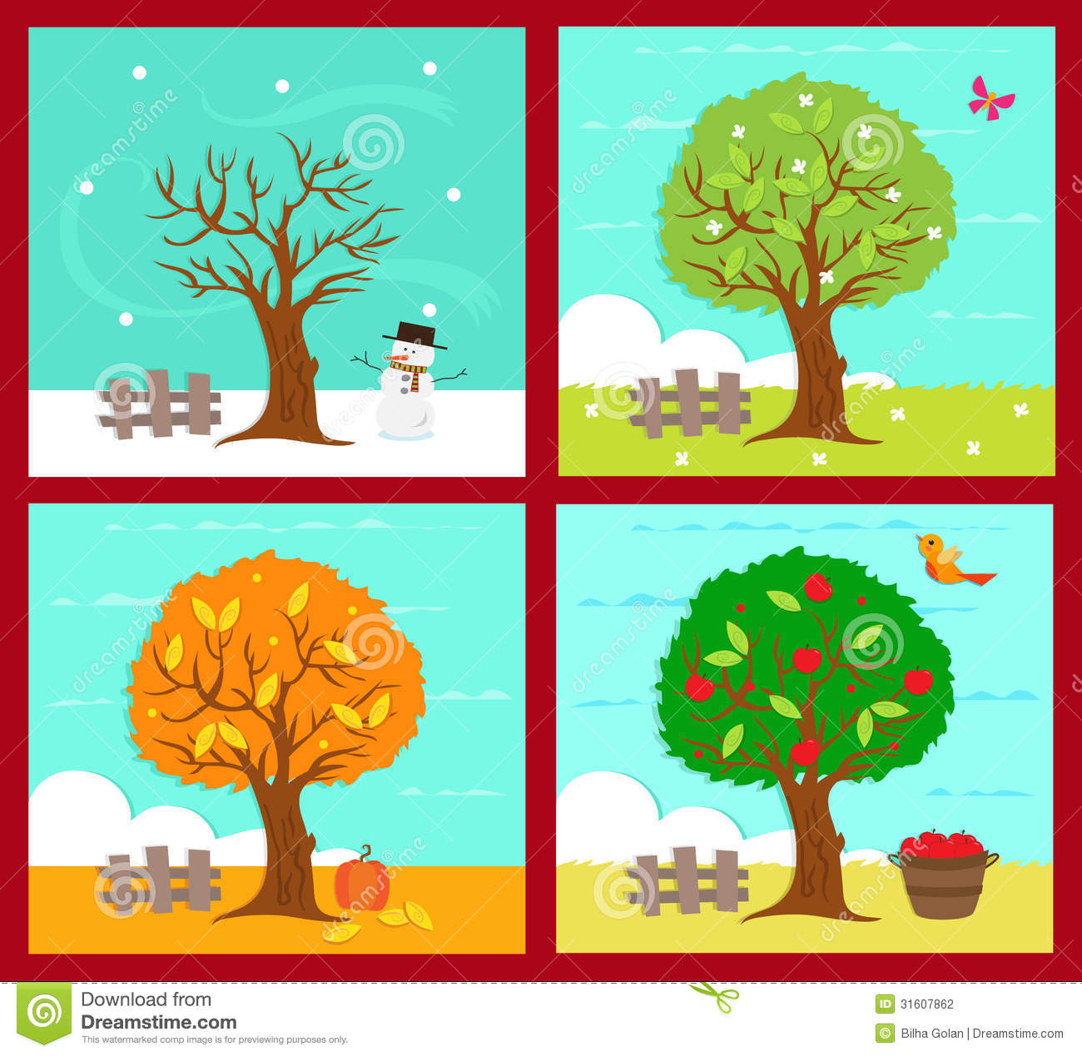
Look at the pictures and name the seasons

Slide 6
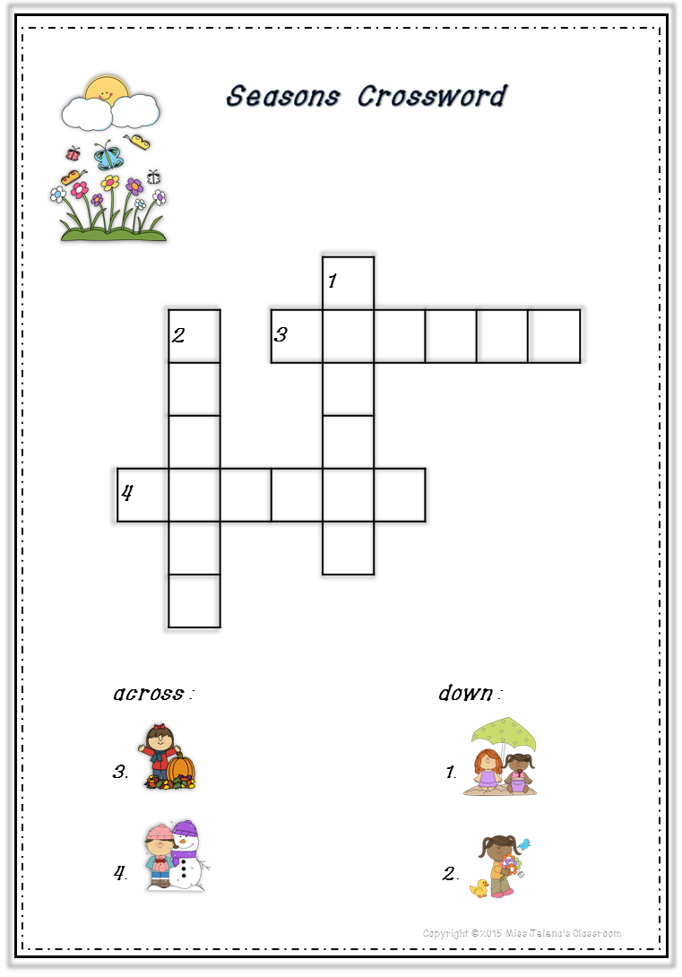
Crossword

Slide 7
Say what month comes…
After: November, December, March, June, February, May
Before: January, April, May, July, August, October, September

Slide 8
Proverbs
Every thing is good in its season
Winter comes fast on the lazy
Chickens are counted in autumn
The must hunger in winter that will not work in summer

Slide 9
Thanks for attention!

