Slide 1
ENGLISH
8-th form
Teacher : Medina Mukambetovna

Slide 2
Good afternoon!

Slide 3
GRAMMAR:
ADJECTIEVES. NOUNS

Slide 5
ADJECTIVES
NOUNS

Slide 6
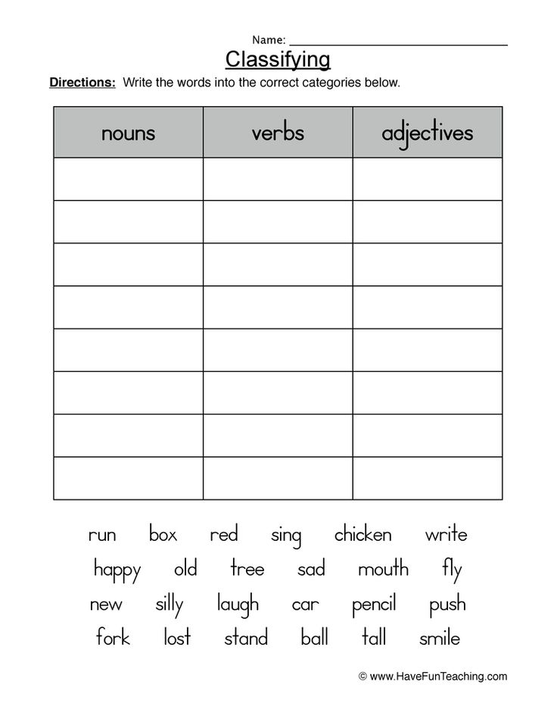
CLASS WORK

Slide 7
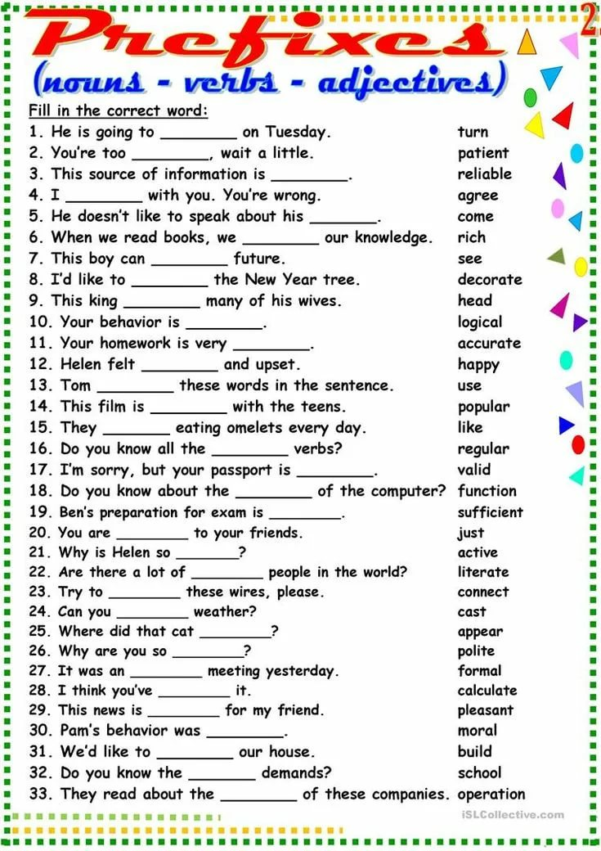

Slide 8
HOMEWORK

Slide 9
GOOD BYE!
SEE YOU LATER!

