Slide 1
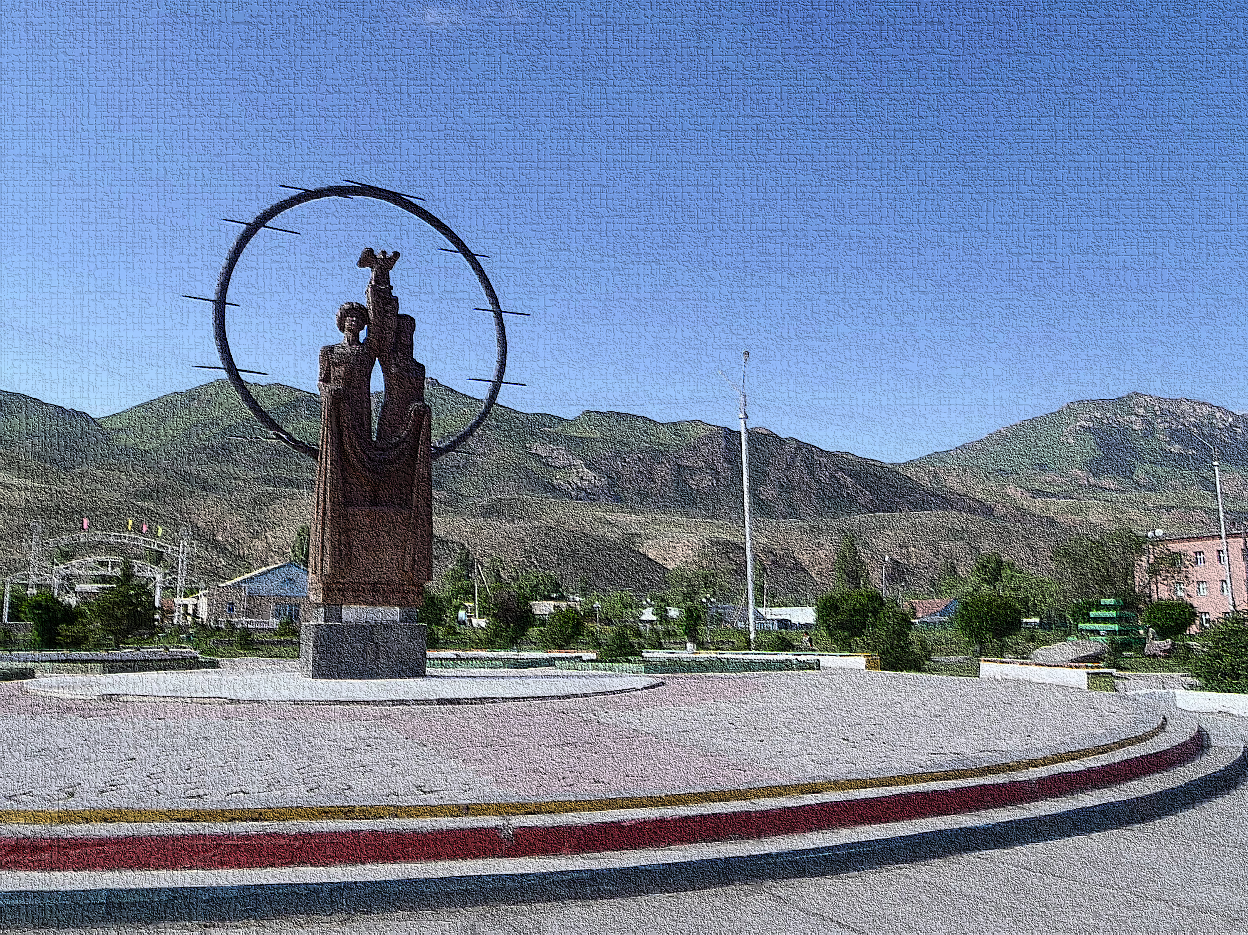
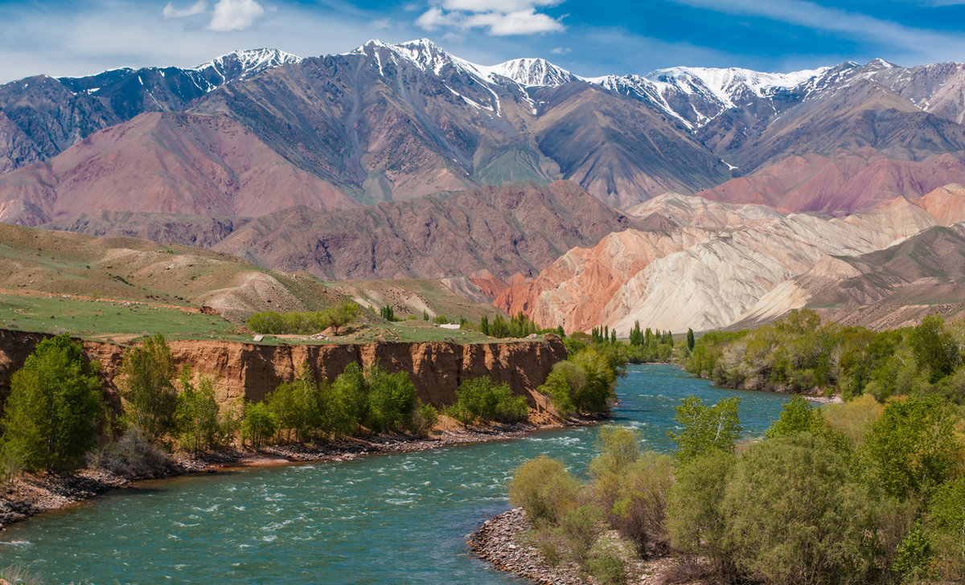
7-th form ENGLISH
TEACHER: MAMBETSEITOVA MEDINA MUKAMBETOVNA

Slide 2
HELLO MY DEAR STUDENTS! HOW ARE YOU?

Slide 3
Theme: LET`S DISCOVER…. KYRGYZSTAN!
LET`S PREPARE OUR TRAVEL BROCHORES ABOUT KYRGYZSTAN. FOLLOW THE INSTRUCTIONS BELOW AND CREATE SOMETHING AMAZING!
ДАВАЙТЕ ПРИГОТОВИМ ТУРИСТИЧЕСКИЕ БРОШЮРЫ О НАШЕМ КЫРГЫЗСТАНЕ. СЛЕДУЙТЕ ПО ИНСТРУКЦИИ НИЖЕ И СОЗДАЙТЕ ЧТО-ТО УДИВИТЕЛЬНОЕ!

Slide 4
KYRGYZSTAN!

Slide 5
KYRGYZSTAN
GRAMMAR-10 POINT
SPELLING-10 POINT
PICTURES AND DESIGN-20POINT
PRESENTATION- 20 POINTS
ГРАММАТИКА-10 БАЛЛОВ
ПРАВОПИСАНИЕ(ОРФОГРАФИЯ) - 10 БАЛЛОВ
КАРТИНКИ И ДИЗАЙН-20 БАЛЛОВ
ПРЕЗЕНТАЦИЯ-20 БАЛЛОВ

Slide 6
1. NAME OF THE COUNTRY
2. THIS IS A FLAG( draw a picture)-10 points
3. LOCATION ( continent, geography, neighboring countries)-15 points
4. LANGUAGE OR LANGUAGES SPOKEN IN THE COUNTRY-10 p.
5. CAPITAL CITY( name and where it is situated)-10 points
6.CURRENCY AND ITS MEANING- 10 points
7. CLIMATE (how many seasons are there? What`s the weather like in different seasons)-15 points

Slide 7
8. FUN THINGS TO DO!-20 points
a)
b)
c)
d)
9.SEE OUR FAMOUS( name there cultural places to visit)-15-points
10.FOOD (choose one famous traditional food. Write the recipe and include a picture)-10 points
11. WHAT ARE SOME IMPORTANT HOLIDAYS?(describe one)-10 p.

Slide 8
12. DID YOU KNOW? ( write some interesting facts about KR)
A)
B)
C)
D)
15 points
COME HERE AND YOU WILL FEEL_______________________!

Slide 9
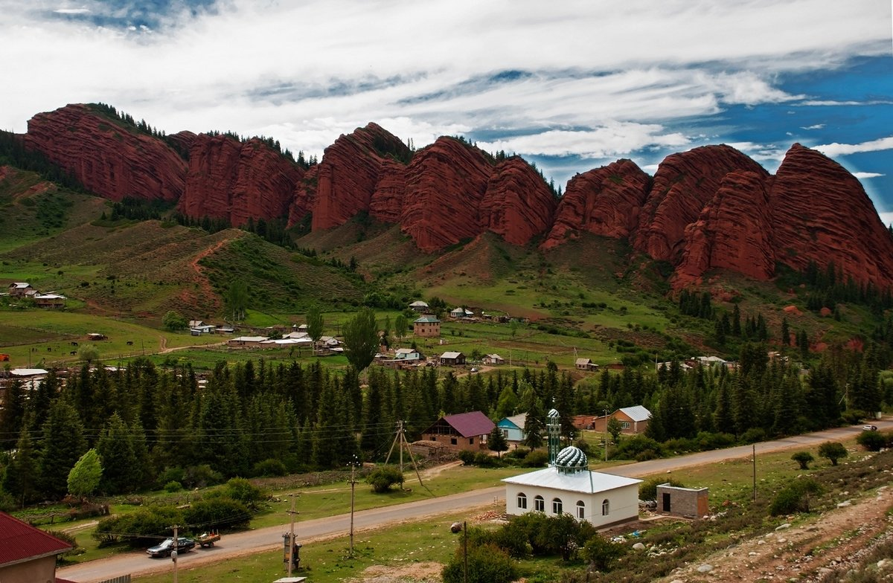

Slide 10
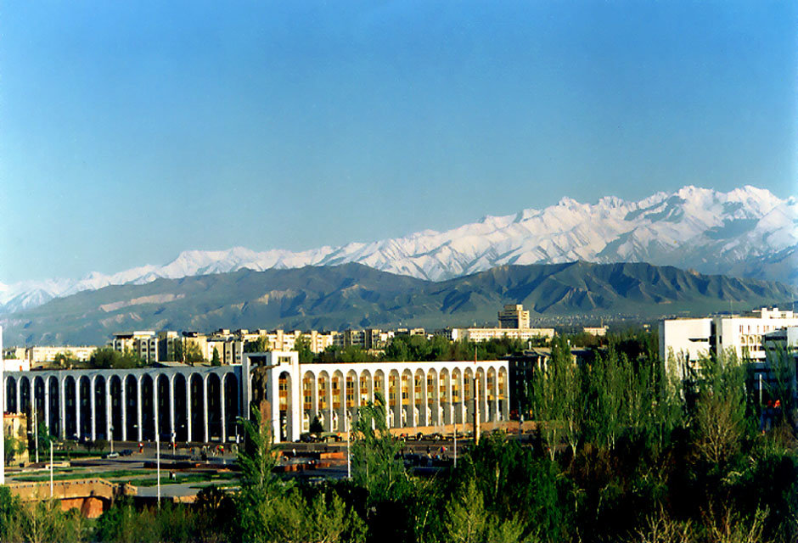
GOOD BYE!

